Slide 1
Angular Bootcamp
10-10-2020
Notes:
https://medium.com/front-end-weekly/typescript-class-vs-interface-99c0ae1c2136

Slide 2
Sunday 11 oct.
1. Front End Comparision with the Back end 11:00 – 11:30
2. NodeJS and NPM 11:30 - 12:00
break (5 min)?
3. TypeScript 12:05 – 13:00
break (5 min)?
4. Vscode 13:05 – 13:30
break (5 min)?
5. Angular Intro 13:35 – 14:30

Slide 3
1. Front End Comparision with the Back end
Intro and background info about tooling and frameworks

Slide 4
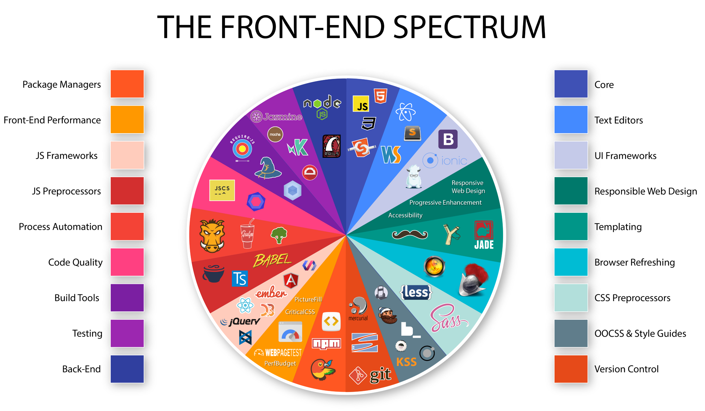



Slide 5

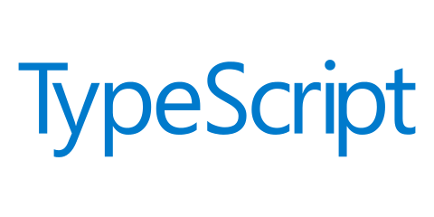




JavaScript Frameworks & Tools
Package
management
(external libraries)
Building the application
For shipping
(Used by Angular CLI)
Programming Language
Design
Framework
NuGet
MSBuild
C#
CSS
ASP.NET
MVC

Slide 6
Front end != Backend
Different conventions and way of thinking
State is one of the most challenging aspect

Slide 7
2. NodeJS and NPM
What can we do with NodeJS and why we need npm?
Handy npm commands
Handson: try out some commands
Package.json and package-lock.json

Slide 8
2. NodeJS and NPM
Global packages
npm init
npm install –g
npm install –save –dev
npm uninstall
npm outdated
rimraf <foldername>
npm install packagename@version –force

Slide 9
3. TypeScript
What is TypeScript?
Types
Interfaces vs Classes
Handson:
Install compiler
Create variables
Create classes
Create Interfaces
Create exportable modules

Slide 10
What is TypeScript
TypeScript is an open source programming language developed and maintained by Microsoft. TypeScript was first made available in October 2012. It was created by Anders Hejlsberg and his team in Microsoft. It is a typed superset of JavaScript that compiles to plain JavaScript.

Slide 11
What is TypeScript
TypeScript adds optional static typing and class-based object-oriented programming to JavaScript. TypeScript may be used to develop JavaScript applications for both client-side or server-side (Node.js) execution. Because browsers only understand JavaScript, when you write your application in TypeScript language, you need a compiler that would compile your code and convert it to JavaScript for your application to work.

Slide 12
Why TypeScript?
TypeScript has now become the smart choice for writing a modern web or JavaScript-based application. It is also known as "JavaScript that scales". Some modern web development libraries like Angular (starting version 2) actually have TypeScript as the required language of development in order to be able to use the library in your application.

Slide 13
Why TypeScript?
TypeScript enables JavaScript developers to use highly-productive development tools and practices like static checking and code refactoring when developing applications. Types are optional, and type inference allows a few type annotations to make a big difference to the static verification of your code. Types let you define interfaces between software components and gain insights into the behavior of existing JavaScript libraries.

Slide 14
TypeScript implemented features from ES6
Strongly typed variables.
Strongly typed function parameters.
Classes.
Interfaces.
Inheritance.
Modules which help divide things into building blocks so more than one person can work on developing one application.
Support for code refactoring tools because everything in TypeScript can have a type.
Support for libraries like Angular and React to use with TypeScript.
Notes:
https://kangax.github.io/compat-table/es6/

Slide 15
TypeScript
Let vs var
var and let are both used for variable declaration in javascript but the difference between them is that var is function scoped and let is block scoped.
It can be said that a variable declared with var is defined throughout the program as compared to let.
Notes:
https://kangax.github.io/compat-table/es6/

Slide 16
TypeScript
console.log(x);
var x=5;
console.log(x);
console.log(x);
let x=5;
console.log(x);
Notes:
https://kangax.github.io/compat-table/es6/

Slide 17
TypeScript
var greeter = "hey hi";
var times = 4;
if (times > 3) {
var greeter = "say Hello instead";
}
console.log(greeter)
Notes:
https://kangax.github.io/compat-table/es6/

Slide 18
TypeScript
let greeting = "say Hi";
let times = 4;
if (times > 3) {
let hello = "say Hello instead";
console.log(hello);// "say Hello instead"
}
console.log(hello)
Notes:
https://kangax.github.io/compat-table/es6/

Slide 19
TypeScript
Classification of types in TypeScript
types are classified into two main classes in TypeScript
1. Basic or Primitive Types
boolean
number
string
array
tuple
enum
null
undefined
any
void: exists purely to indicate the absence of a value, such as in a function with no return value.
2. Complex or Non-Primitive Types
class
interface
Basic and Complex types are covered in detail in the next lesson.

Slide 20
TypeScript: Interfaces vs classes
Notes:
https://medium.com/front-end-weekly/typescript-class-vs-interface-99c0ae1c2136

Slide 21
TypeScript: Handson
Create a movie class with properties and types using number, string and enum, arrays
Call the instance of the movie
Define a new property of the movie using an interface
Make use of array method, filter, map, foreach, spread operator
Anonymous methods
Create exportable interfaces
Notes:
https://kangax.github.io/compat-table/es6/

Slide 22
4. Vscode
Extensions
Terminal
Shortcuts
User settings

Slide 23
4. Angular Intro
What is the framework consist of
Folder structure
angular.json
tsconfig.json
Style guide
Angular CLI and handson
Generate app
Generate components

